Slide 1

RECURRENT NEURAL NETWORKS
Tam HO
Notes:
Hello Hello, everyone, so today Im going to show you the topic
Topic ; Reccurrent NN

Slide 2


Content
Recurrent Neural Networks
Long Short-Term Memory
Gated Recurrent Units
Implementation from scratch
Notes:
And The content of the presentation includes:

Slide 3
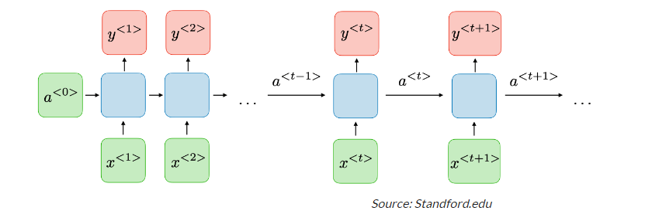
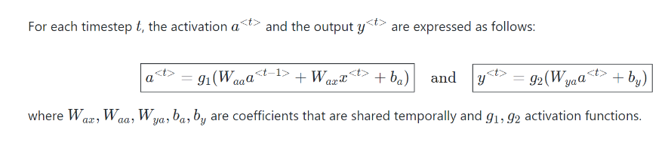
RECURRENT NEURAL NETWORKS
1
Notes:
As I know, the architecture of RNN is also included : Input + Hidden state and Output.
RNNs are a type of neural network that has hidden states and allows past outputs to be used as inputs.
The activation : 3 sigmoid + Tanh + Relu.
We always have the expression output y=Wx+b, where W : weight, b: bias , x : input. So in RNN , the equation is covered by a activate function.

Slide 4
RECURRENT NEURAL NETWORKS
RNN Applications
Recurrent Neural Networks are used to tackle a variety of problems involving sequence data. There are many different types of sequence data, but the following are the most common: Audio, Text, Video, Biological sequences.
Using RNN models and sequence datasets, we may tackle a variety of problems, including :
Speech recognition
Generation of music
Automated Translations
Analysis of video action
Sequence study of the genome and DNA
2
Notes:
We can summarize that A neural network that uses recurrent computation for hidden states is called a recurrent neural network (RNN). The hidden state of an RNN can capture historical information of the sequence up to the current time step. With recurrent computation, the number of RNN model parameters does not grow as the number of time steps increases.
As for applications:

Slide 5
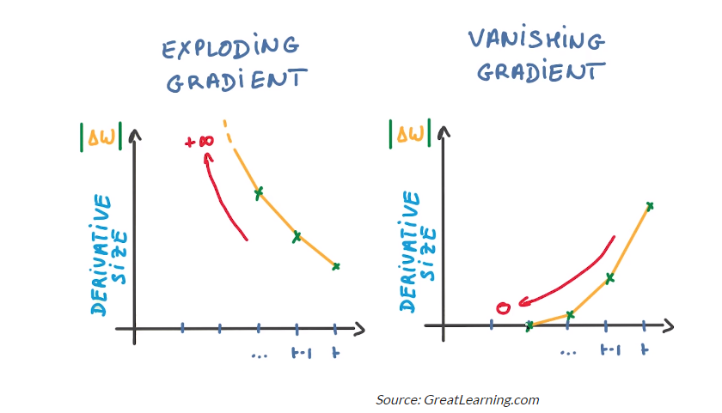
2. LONG SHORT TERM MEMORY(LSTM)
Two issues of Standard RNNs:
Exploding Gradients
Vanishing Gradients
3
Notes:
A function’s slope is also known as its gradient. The steeper the slope, the faster a model can learn, the higher the gradient. The model, on the other hand, will stop learning if the slope is zero. A gradient is used to measure the change in all weights in relation to the change in error.
Exploding Gradients: Exploding gradients occur when the algorithm gives the weights an absurdly high priority for no apparent reason. Fortunately, truncating or squashing the gradients is a simple solution to this problem.
Vanishing Gradients: Vanishing gradients occur when the gradient values are too small, causing the model to stop learning or take far too long. This was a big issue in the 1990s, and it was far more difficult to address than the exploding gradients.
Fortunately, we can use LSTM method to solved this problem.

Slide 6
2. LONG SHORT TERM MEMORY(LSTM)
There are a total of three gates that LSTM uses as:
Input Gate: The input gate decides what information will be stored in long term memory. It only works with the information from the current input and short term memory from the previous step. At this gate, it filters out the information from variables that are not useful.
Forget Gate: The forget decides which information from long term memory be kept or discarded and this is done by multiplying the incoming long term memory by a forget vector generated by the current input and incoming short memory.
Output Gate: The output gate will take the current input, the previous short term memory and newly computed long term memory to produce new short term memory which will be passed on to the cell in the next time step. The output of the current time step can also be drawn from this hidden state.
4
Notes:
Long Short Term Memory in short LSTM is a special kind of RNN capable of learning long term sequences. And
Slide
So this is all about the mechanism of LSTM to realise this with practical

Slide 7
3. GATED RECURRENT UNITS(GRU)
GRU incorporates the two gate operating mechanisms called Update gate and Reset gate.
Update gate: The update gate is responsible for determining the amount of previous information that needs to pass along the next state. This is really powerful because the model can decide to copy all the information from the past and eliminate the risk of vanishing gradient.
Reset gate: The reset gate is used from the model to decide how much of the past information is needed to neglect; in short, it decides whether the previous cell state is important or not.
5
Notes:
The workflow of the Gated Recurrent Unit, in short GRU, is the same as the RNN but the difference is in the operation and gates associated with each GRU unit. To solve the problem faced by standard RNN,
First, the reset gate comes into action it stores relevant information from the past time step into new memory content.
Then it multiplies the input vector and hidden state with their weights. Next, it calculates element-wise multiplication between the reset gate and previously hidden state multiple. After summing up the above steps the non-linear activation function is applied and the next sequence is generated.
This is all about the operation of GRU

Slide 8
3. LSTM and GRU
What is the difference between GRU & LSTM?
The few differencing points are as follows:
The GRU has two gates, LSTM has three gates GRU does not possess any internal memory, they don’t have an output gate that is present in LSTM In LSTM the input gate and target gate are coupled by an update gate and in GRU reset gate is applied directly to the previous hidden state. In LSTM the responsibility of reset gate is taken by the two gates input and target.
LSTM and GRU, GRU uses less training parameter and therefore uses less memory and executes
faster than LSTM whereas LSTM is more accurate on a larger dataset. One can choose LSTM if you are dealing with large sequences and accuracy is concerned, GRU is used when you have less memory consumption and want faster results.
6
Notes:
Finally, and

Slide 9
4. IMPLEMENTSTION FROM SCRATCH
How to Implementation from Scratch GRU & LSTM?
Step 1 : Load the dataset
Step 2: Initializing model parameters
Step 3: Definiting the model
Step 4: Training and Prediction
7
Notes:
To gain a better understanding of the LSTM and GRU model, let’s implement it from scratch.
I COULD summarize it in 4 step like :

Slide 10
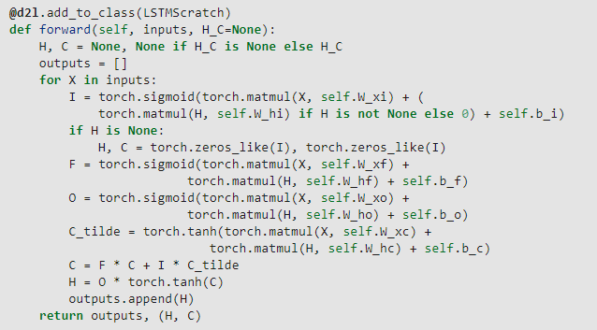
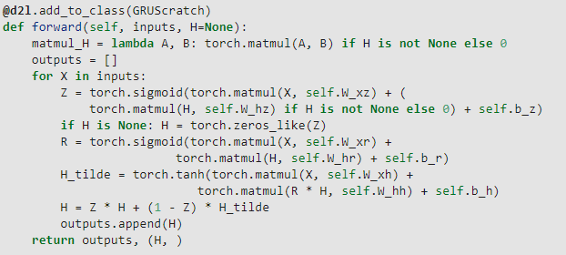
4. IMPLEMENTATION FROM SCRATCH
8
Notes:
Both of LSTM and GRU has the same implementation but only differs from Define model in compute calculation .
this is the code that updates the values of the quantities of the 2 methods

Slide 11
THANKS FOR YOUR ATTENTION

